Slide 1

Image Depth Estimation
Team Num:I8
Under the guidance of
Dr. Meena S.M
Shreya B Devagiri 01FE20BCS019
Rohit Devaranavadagi 01FE20BCS246
Sneha K Pamali 01FE20BCS035
Nishant R Negali 01FE20BCS204

Slide 2

Project Overview
Domain: Data Analytics / AI and ML
Problem Space:
A deep neural network is a part of deep learning used to solve real world problems like classification, depth estimation,
Machine learning can extract structured information from unstructured data.
Problem Statement:
To estimate the depth of each pixel in an image, given a single 2D image as input this is referred to as image depth estimation. The approach to this problem is to use machine learning techniques to learn a mapping from the 2D image to the depth map generation.

Slide 3
Technical challenges
There are a number of challenges involved in depth estimation, including:
Variability in the appearance of objects in images due to changes in their position and orientation relative to the camera: This can make it difficult for algorithms to accurately estimate the depths of objects in images, especially when the appearance of the objects is significantly different from what the algorithm has been trained on.
Occlusions, reflections, and transparent objects: These can make it difficult to accurately estimate the depths of all objects in the scene, as some objects may be partially or completely hidden from view.
Low-quality images: Images with low resolution or poor lighting conditions can make it difficult for algorithms to accurately estimate depths.
Extreme camera angles or distortion: This can cause objects in the image to appear distorted or foreshortened, making it difficult to accurately estimate their depths.
A wide range of depths and scene types: Algorithms may struggle to handle a wide range of depths and scene types, such as scenes with a large number of objects or complex geometric structures.
Integration with other tasks: Depth estimation may need to be integrated with other tasks, such as object recognition and tracking, to improve the performance of these tasks in complex and dynamic environments.

Slide 4
Objectives
To implement and compare among various methods and algorithms for Object detection, Segmentation and Generation of Depth Map.
To perform object detection followed by instance segmentation on a given image for depth estimation.
To generate a depth map for the segmented image for depth prediction.
To produce better results than already existing state of the art algorithms and models.

Slide 5
Functional Requirements
The system shall be able to handle a large number of images and generate the depth map for the given image.
The system shall be able to handle with larger number of objects in a image and for that image an appropriate depth map will be generated.
The system shall be able to handle different types of input data, such as images with different resolutions or aspect ratios.
The system shall be able to predict the depth map which is close to the ground truth of the image.

Slide 6
Non-Functional Requirements
The non-functional requirements are as follows:
The system should generate the depth map in a reasonable amount of time, as it may be used in real time applications.
The system should be reliable and consistently produce accurate depth maps.
The system should have good performance, with fast processing time and low latency.
The system should be easy to use, with a clear and intuitive interface.

Slide 7
Literature Survey

Slide 8

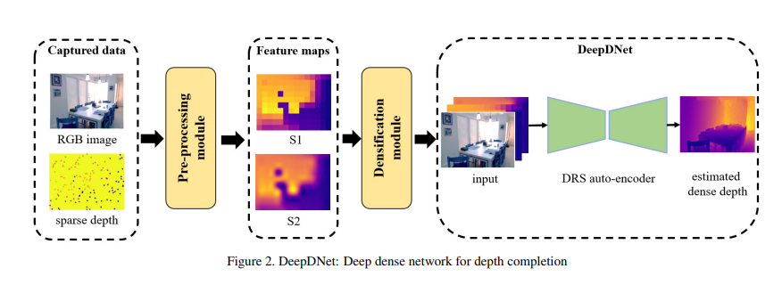
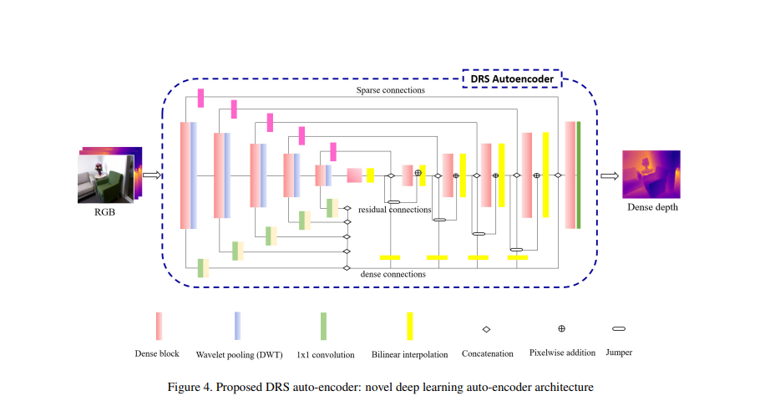
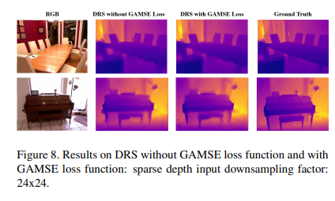
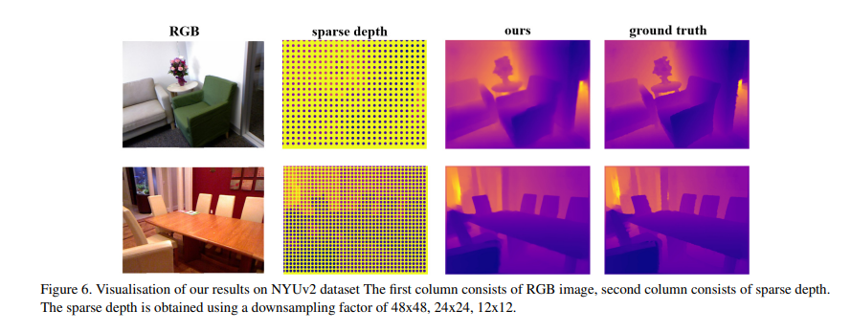
DeepDNet: Deep Dense Network for Depth Completion Task
TM
Introduction :
A Deep Dense Network for Depth Completion Task (DeepDNet) towards generating dense depth map using sparse depth and captured view.
Methodology :
Model Architecture :
The pre-processing block that introduces the conversion of acquired input RGB and sparse depth to the desired feature maps.
DRS autoencoder.
Advancement on MSE by introducing new gradient aware error term GAMSE loss. This new loss function helps the model with fast convergence, enhanced stability and edge preservation.
Objectives :
To utilize the accurate sparse depth as input with RGB image to generate dense depth.
Paying more attention to edge preservation.
To resolve the problems related to depth such as, producing convincing occlusions and consistent depth prediction across frames to avoid flickering.
Results:
Conclusion:
DRS Auto Encoder network can operate on sparse depth information and RGB image to produce accurate dense depth maps similar to that of dedicated sensor hardware.

Slide 9
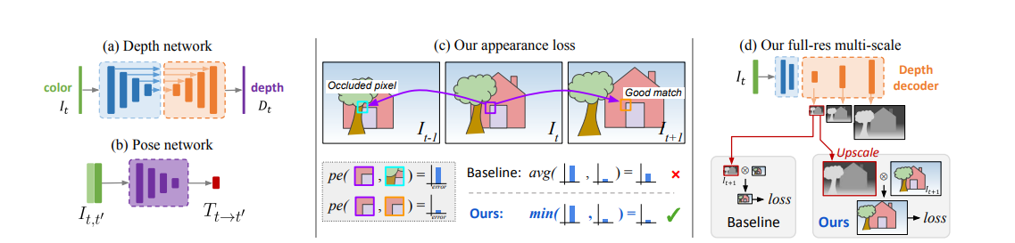
Digging Into Self-Supervised Monocular Depth Estimation
TM
Introduction :
Quantitatively and qualitatively improved depth maps compared to competing self-supervised methods.
Methodology :
Objectives :
(i) A minimum reprojection loss, designed to robustly handle occlusions, (ii) A full-resolution multi-scale sampling method that reduces visual artifacts, and (iii) An auto-masking loss to ignore training pixels that violate camera motion assumptions.
Model Architecture :
(a) Depth network: We use a standard, fully convolutional, U-Net to predict depth.
(b) Pose network: Pose between a pair of frames is predicted with a separate pose network.
(c) Per-pixel minimum reprojection: When correspondences are good, the reprojection loss should be low. However, occlusions and disocclusions result in pixels from the current time step not appearing in both the previous and next frames. The baseline average loss forces the network to match occluded pixels, whereas our minimum reprojection loss only matches each pixel to the view in which it is visible, leading to sharper results.
(d) Full-resolution multi-scale: We upsample depth predictions at intermediate layers and compute all losses at the input resolution, reducing texture-copy artifacts.
Results:
93% of the Eigen split test frames have higher quality ground truth depths. The reprojected LIDAR scans to compare our method against several existing baseline algorithms, still showing superior performance.
Conclusion:
(i) A minimum reprojection loss, computed for each pixel, to deal with occlusions between frames in monocular image.
(ii) An auto-masking loss to ignore confusing, stationary pixels.
(iii) A full-resolution multi-scale sampling method. We showed how together they give a simple and efficient model for depth estimation, which can be trained with monocular video data, stereo data, or mixed monocular and stereo data.

Slide 10
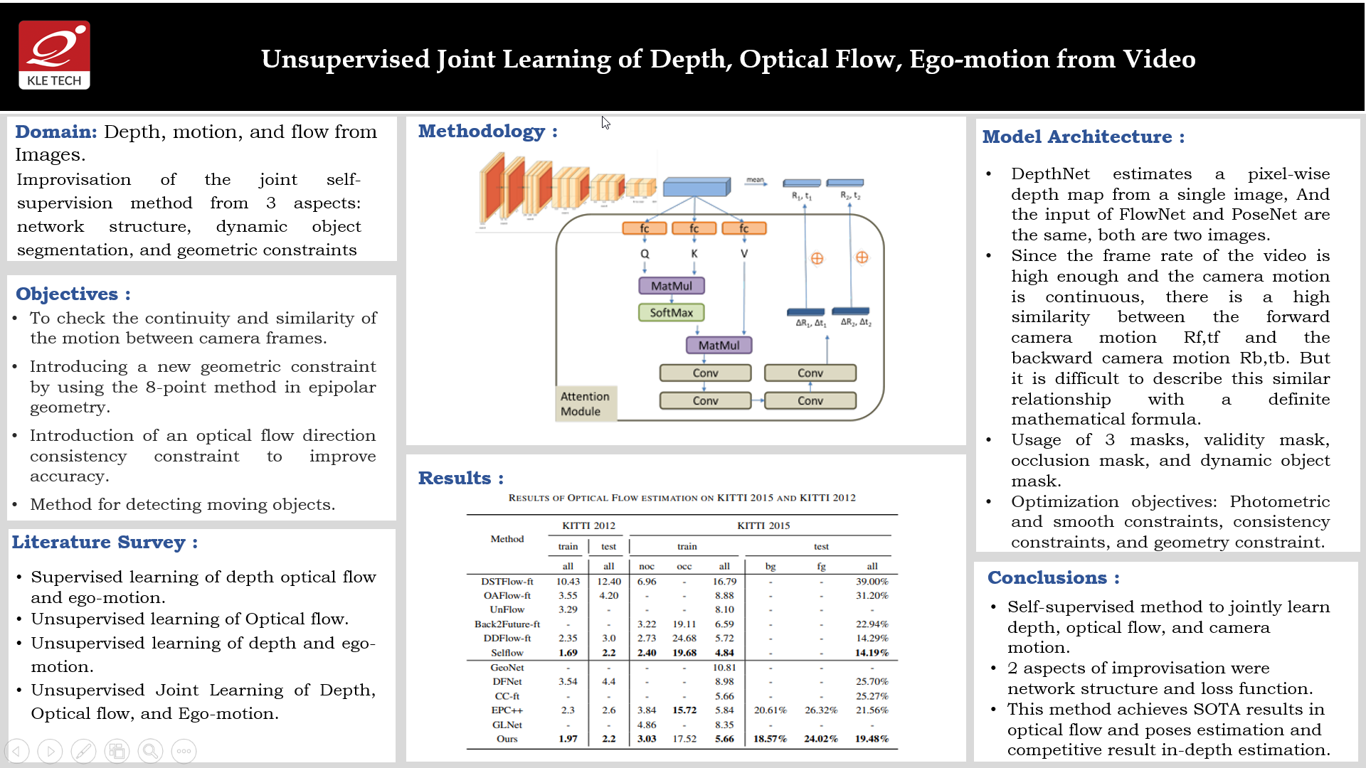

Slide 11
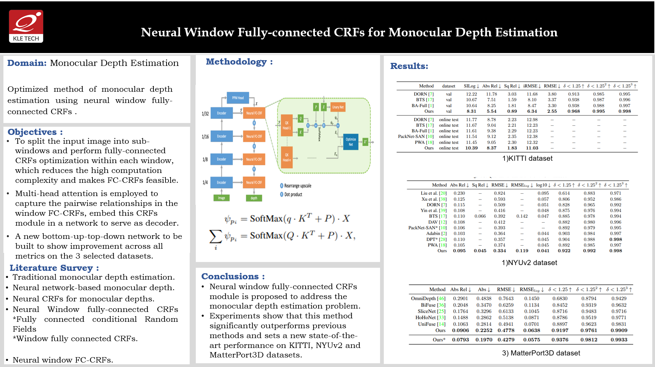

Slide 12
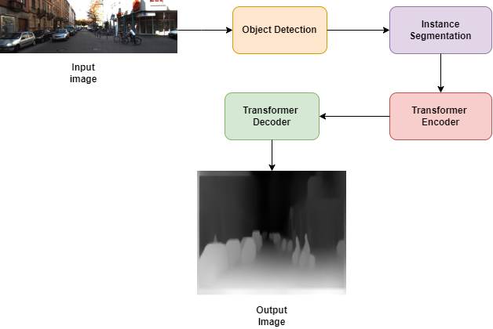
Proposed System
Overview of proposed system

Slide 13
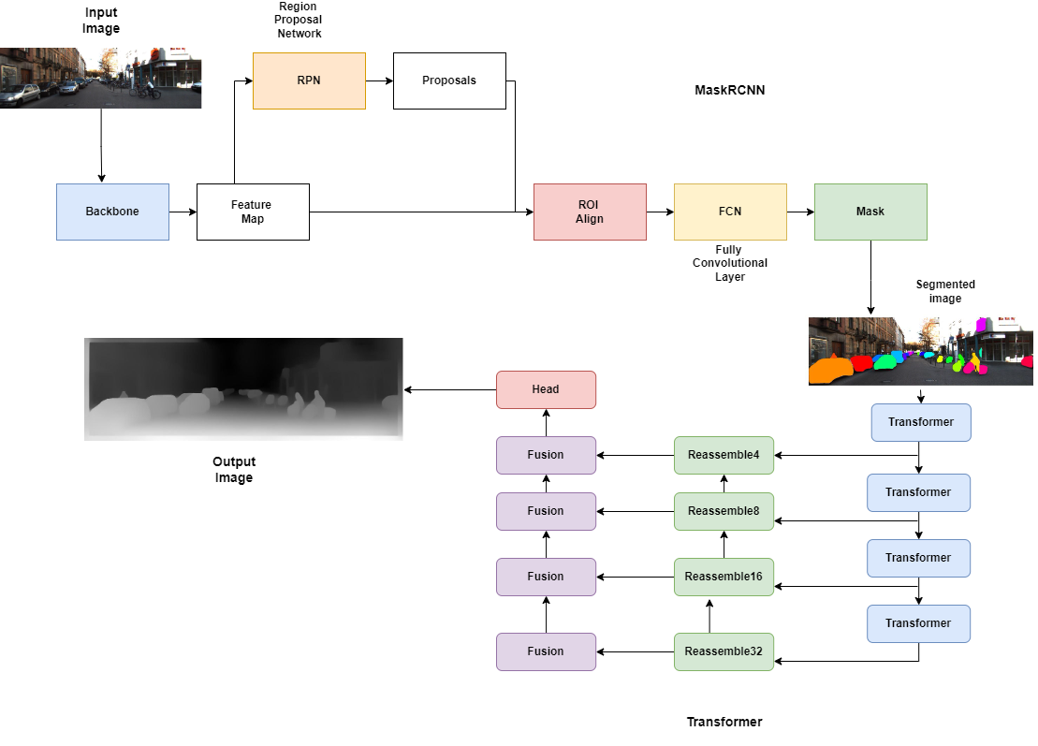
Architecture
Proposed System Architecture

Slide 14
Dataset Description
The KITTI dataset is a large dataset of images and 3D point clouds captured by a vehicle-mounted LiDAR and camera system. The dataset was collected by the Karlsruhe Institute of Technology and Toyota Technological Institute and is widely used for evaluating algorithms in the fields of autonomous driving, robotics, and computer vision.
The KITTI dataset consists of a number of different data modalities, including stereo images, monocular images, LiDAR point clouds, and GPS/INS data. The dataset also includes ground truth data for a variety of tasks, including object detection, object tracking, 3D object reconstruction, and depth estimation.
One of the key features of the KITTI dataset is the wide range of scenarios it covers, including urban, suburban, and rural environments, as well as different weather conditions and lighting conditions. This makes it a useful benchmark for evaluating the performance of algorithms on a wide range of different types of data.
Overall, the KITTI dataset is a valuable resource for researchers working on problems related to autonomous driving, robotics, and computer vision, and has been widely used in a variety of research studies and applications.

Slide 15
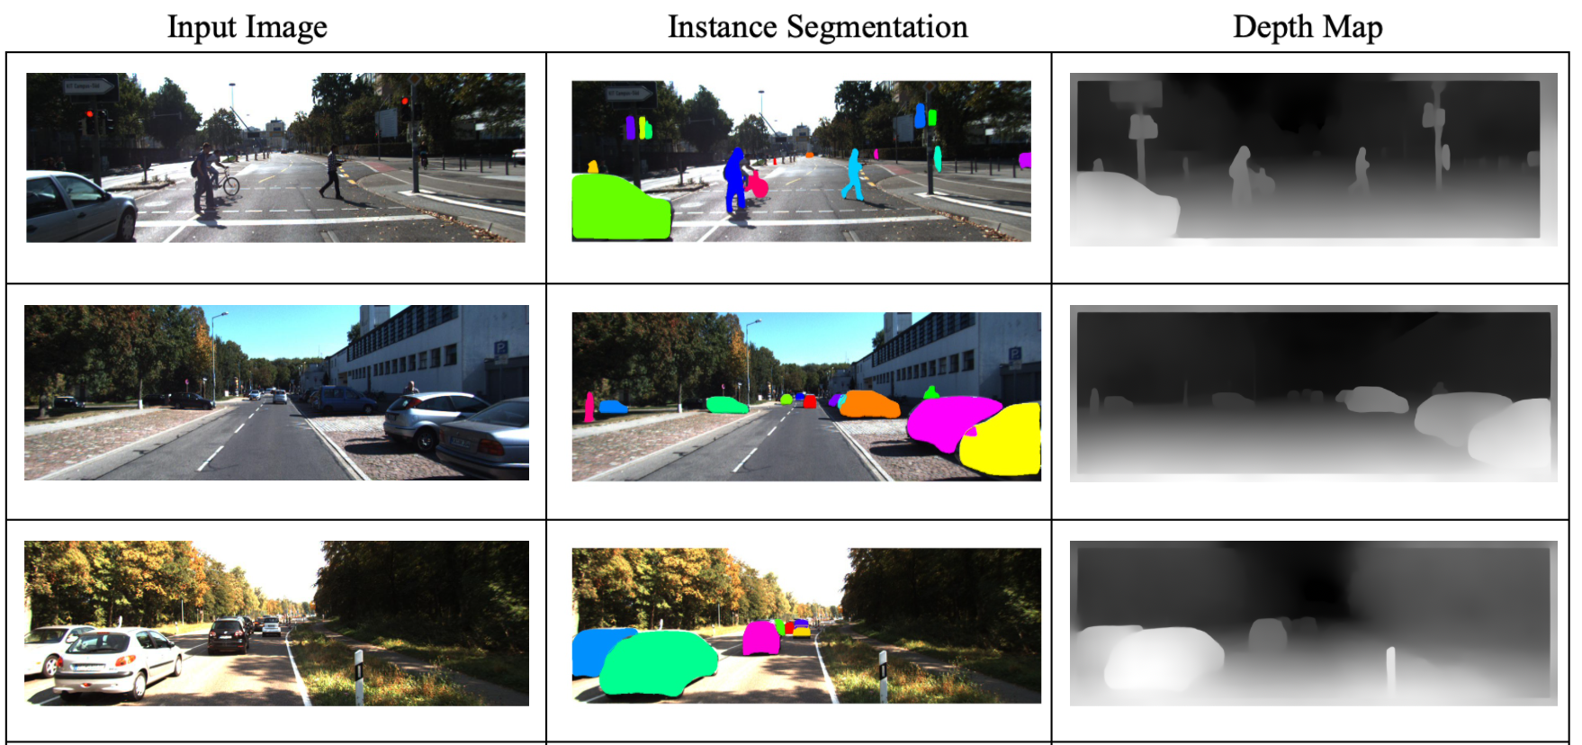
Results (On KITTI Dataset)

Slide 16

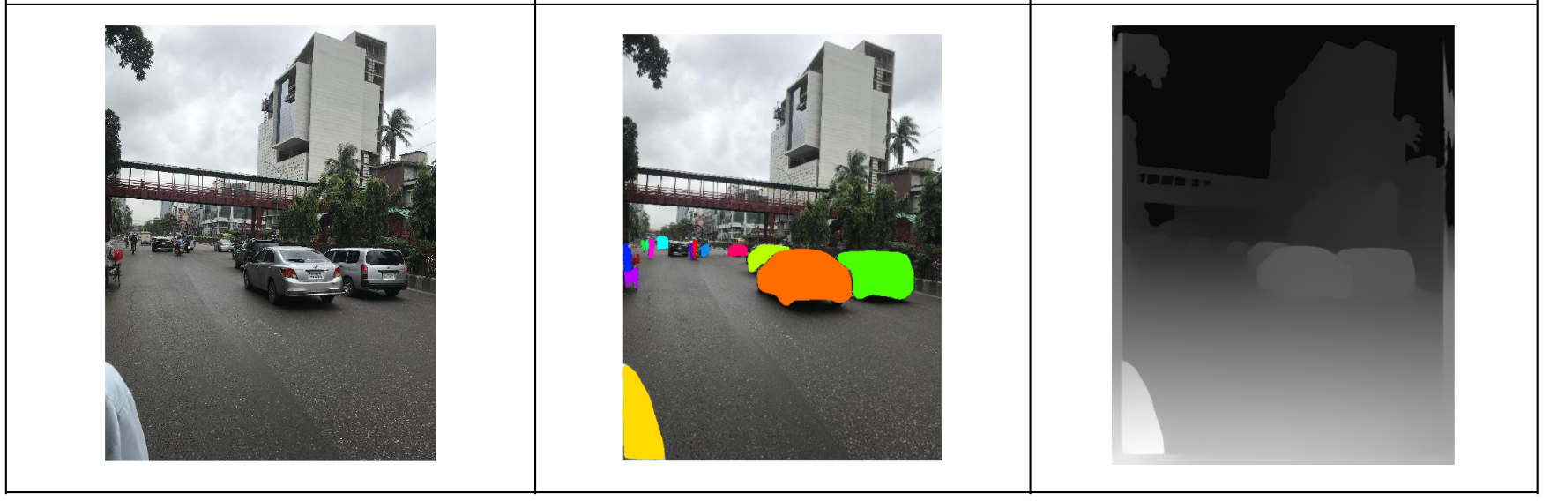
Results (On Indian Road)

Slide 17
Conclusion
We proposed a novel methodology to estimate the depth of an image by designing a multi-picture depth prediction network using transformers. To create a depth map without the aid of ground truth depth, the input image's objects were identified, and after instance segmenting them, the objects were passed to the transformers.

Slide 18
Future Scope
To integrate image depth estimation with other tasks, such as object recognition and tracking, to improve the performance of these tasks in complex and dynamic environments.
There is also potential for image depth estimation to be used in a wider range of applications, such as virtual and augmented reality, where it can be used to provide a more realistic and immersive experience.
Image depth estimation may be used in autonomous systems, such as self-driving cars and drones, to improve their ability to navigate and avoid obstacles in their environment.
The scope of image depth estimation is likely to continue to grow and evolve in the coming years, as researchers and developers seek to leverage the power of this technology to solve a wide range of problems in fields such as robotics, augmented reality, and computer vision.

Slide 19
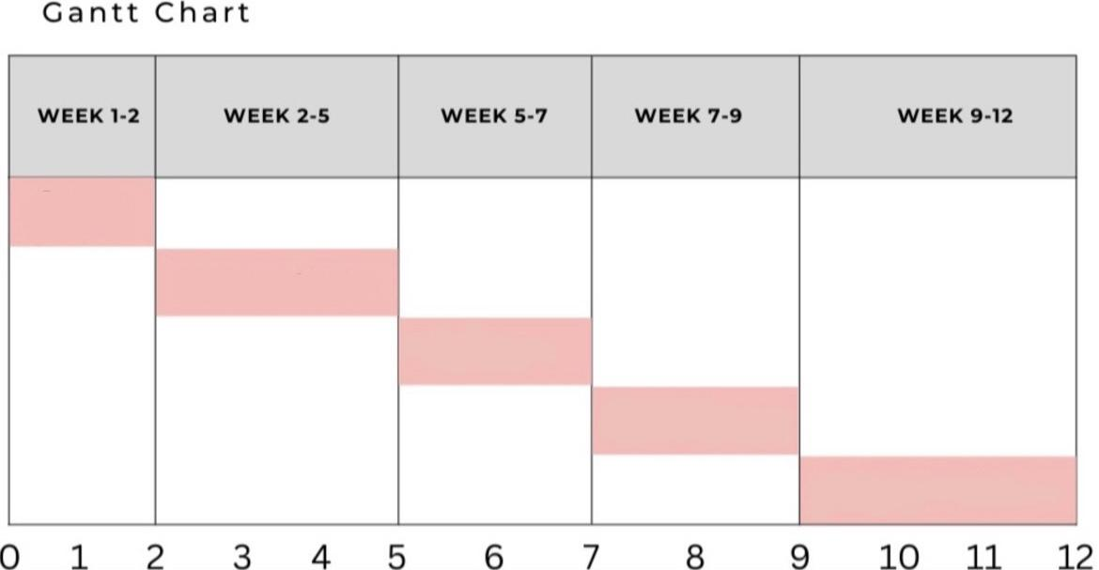
Gantt Chart
Problem Definition
Literature Survey
Algorithm Selection
Implementation
Results & Testing

Slide 20
References
[1] Zhaowei Cai Nuno Vasconcelos.Cascader-cnn:Delving into high quality object detection. In The IEEE Conference on Computer Vision and Pattern Recognition (CVPR), 2021.
[2] Eric Brachmann, Frank Michel, Alexander Krull, Michael Ying Yang, Stefan Gumhold, and Carsten Rother. Uncertainty-driven 6d pose estimation of objects and scenes from a single rgb image. In The IEEE Conference on Computer Vision and Pattern Recognition (CVPR), 2020.
[3] B. Calli, A. Walsman, A. Singh, S. Srinivasa, P. Abbeel, and A. M. Dollar. Benchmarking in manipulation research: Using the yale-cmu-berkeley object and model set. IEEE Robotics Automation Magazine, 22(3):36–52, 2019.
[4] Nicolas Carrion, Francisco Massa, Gabriel Synnaeve,Nicolas Usunier, Alexander Kirillov, and Sergey Zagoruyko. End- to-end object detection with transformers. In The European Conference on Computer Vision (ECCV), 2020.
[5] Marius Cordts, Mohamed Omran, Sebastian Ramos, Timo Rehfeld, Markus Enzweiler, Rodrigo Benenson, Uwe Franke, Stefan Roth, and Bernt Schiele. The cityscapes dataset for semantic urban scene understanding. In Proc. of the IEEE Conference on Computer Vision and Pattern Recognition (CVPR), 2018.

Slide 21
Thank You!

